Slide 1

Data Analysis Report: Tools & Insights
This comprehensive data analysis report leverages a variety of powerful tools - Excel, Microsoft Power BI, Tableau, and MySQL - to uncover valuable insights from the data. The findings cover key aspects of the project, from payment statistics to delivery times and product pricing.

Slide 2
Project Overview
1
Weekday vs Weekend Payment Statistics
2
Orders with 5-Star Reviews and Credit Card Payments
3
Average Delivery Time for Pet Shop Orders
Analyzing the differences in payment patterns between weekday and weekend orders.
Evaluating the delivery performance for orders from the pet shop segment.
Identifying the number of orders with the highest review score and credit card as the payment type.
4
Pricing and Payment Analysis in São Paulo
5
Shipping Days and Review Scores
Investigating the relationship between delivery time and customer satisfaction.
Examining the average price and payment values for the São Paulo market.

Slide 3

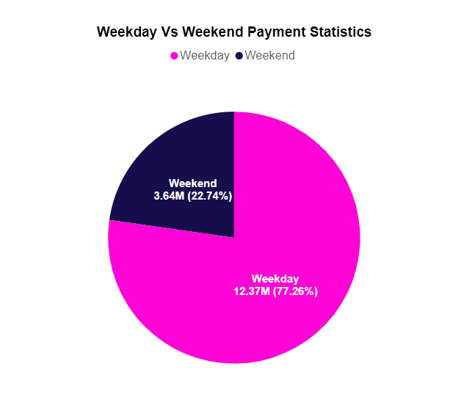
Weekday vs Weekend Payment Statistics
Weekday Orders
Trends and Insights
Higher volume of transactions, with a broader range of payment methods utilized.
Weekday orders demonstrate more diversity in payment preferences, while weekend buyers tend to favor credit cards.
1
2
3
Weekend Orders
Lower overall order volume, but a larger proportion of credit card payments.

Slide 4
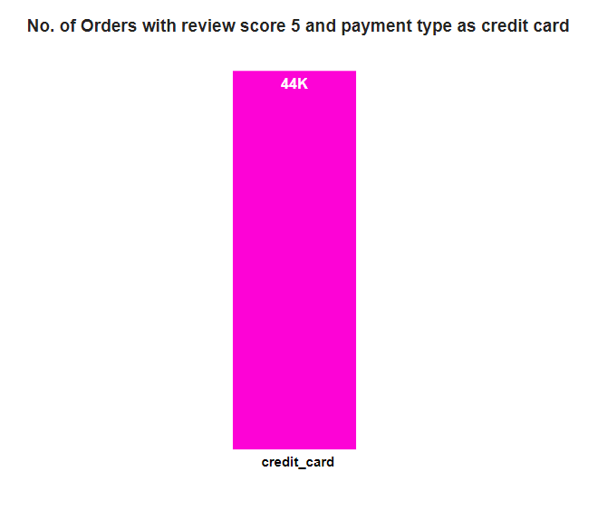
Orders with 5-Star Reviews and Credit Card Payments
5-Star Reviewed Orders
Credit Card Payments
Insights
A significant portion of the highest-rated orders were paid for using credit cards.
The data suggests a correlation between credit card usage and customer satisfaction, as reflected in the review scores.
This insight could inform marketing and payment processing strategies to enhance the customer experience.

Slide 5
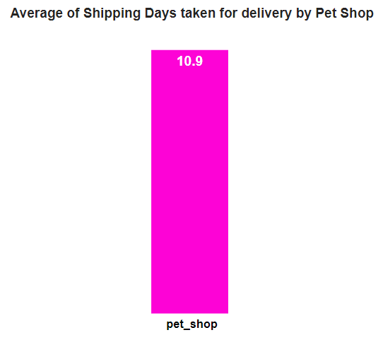

Average Delivery Time for Pet Shop Orders
Consistent Performance
Room for Improvement
The average delivery time for pet shop orders has remained relatively stable over the analysis period.
While the delivery times are consistent, there may be opportunities to further optimize the supply chain and logistics for this segment.
Potential Factors
Next Steps
Factors such as product size, weight, and handling requirements may influence the delivery times for pet shop orders.
Further analysis of the pet shop delivery data could uncover opportunities to enhance the customer experience.

Slide 6
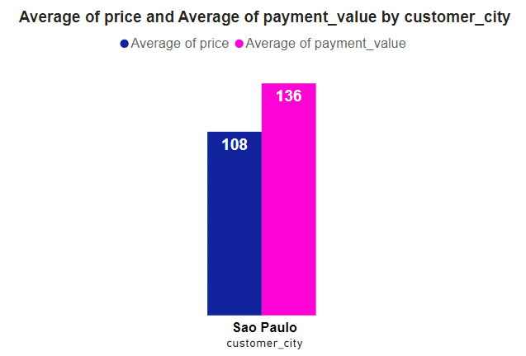
Average Price and Payment Values from São Paulo City
Product Pricing
Payment Values
Insights
The average product prices in São Paulo show a moderate range, with some higher-end and more affordable items.
The payment values exhibit a wider distribution, reflecting the diverse purchasing power and payment preferences of São Paulo customers.
This data can inform pricing strategies, product selection, and payment processing optimization for the São Paulo market.

Slide 7
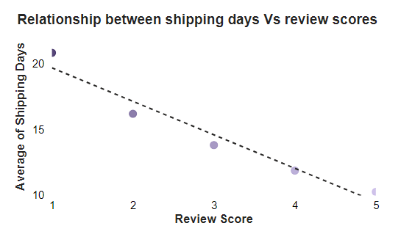



Relationship between Shipping Days and Review Scores
Faster Delivery
Orders with shorter shipping times tend to receive higher review scores from customers.
Longer Delivery
Orders with longer shipping times are more likely to receive lower review scores.
Insights
This correlation highlights the importance of optimizing delivery times to enhance customer satisfaction and loyalty.

Slide 8





Detailed Analysis
Data Sources
Analytical Tools
Leveraged multiple data sources, including MySQL databases and external datasets.
Employed advanced analytics platforms such as Excel, Power BI, and Tableau.
Key Insights
Recommendations
Uncovered valuable insights across payment trends, product pricing, and delivery performance.
Provided actionable recommendations to optimize operations and enhance the customer experience.

Slide 9
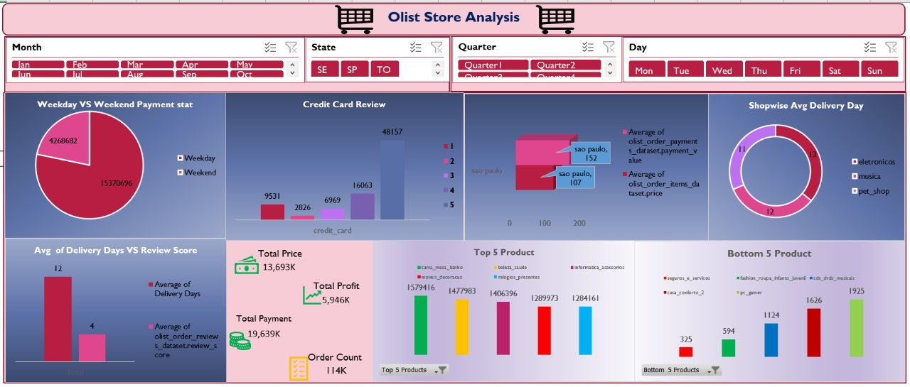
Excel Dashboard

Slide 10
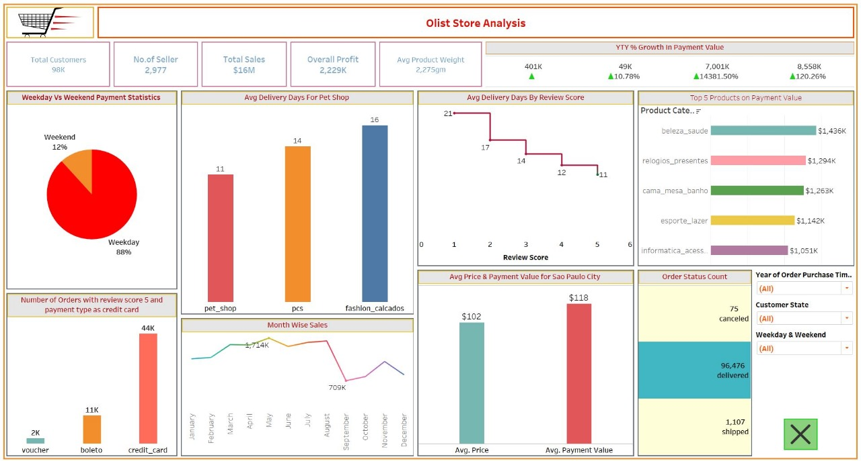
Tableau Dashboard

Slide 11
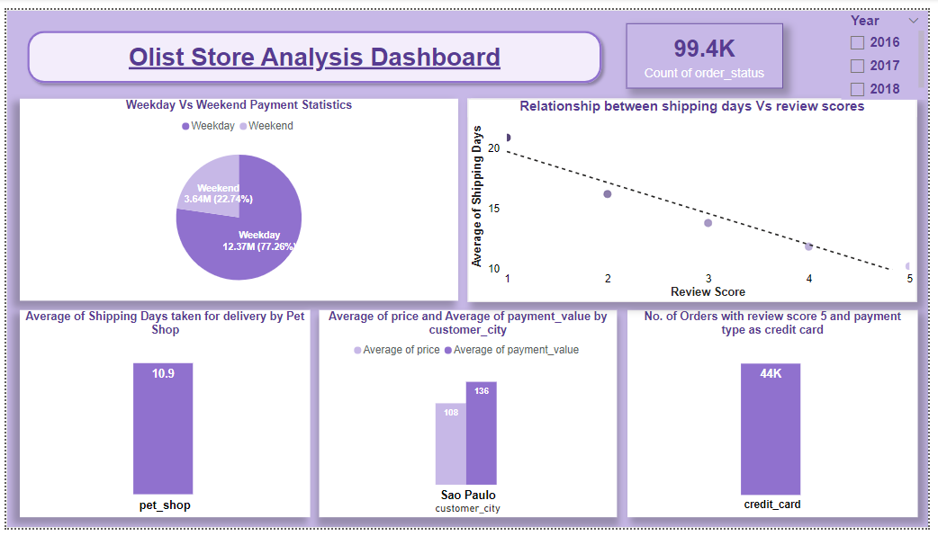
Power Bi Dashboard

Slide 12
Thank You

